Slide 1
LOWER SIXTH ARTS
GEOGRAPHY
Lesson 15
Contrasts in Development within Cameroon
Notes:
Good morning, class, and welcome to our geography lesson. I am your geography teacher, Mr Kamdem. Today we are starting Lesson 15: Contrasts in Development within Cameroon.

Slide 2
CLASS INFO
Class, Chapter and Duration
Class | Lower Sixth Arts
Chapter | Geography of Cameroon
Duration | 2 periods (2 × 50 minutes)
Notes:
This lesson is for Lower Sixth Arts. It belongs to Geography of Cameroon. We shall need 2 periods to cover it.

Slide 3
IDENTIFICATION
Lesson Identification
Topic | Geography of Cameroon
Sub-topic | Economic Activities and Development of Cameroon
Lesson | Lesson 15: Contrasts in Development within Cameroon
Notions / Concepts | Development, regional inequality, core, periphery, backwash effects, spread effects, indicators of development, decentralisation.
Syllabus focus | Recall of the models of regional inequality (Friedmann and Myrdal); contrasting regions (case study: Adamawa versus the Coastal lowlands); indicators of differences in development; factors; measures attempted to reduce inequality.
Competence | Learners are able to explain the contrasts in development between regions of Cameroon and assess the measures taken to reduce them.
Notes:
Our topic is Geography of Cameroon, and the sub-topic is Economic Activities and Development of Cameroon. The key notions we shall use today are: development, regional inequality, core, periphery, backwash effects, spread effects, indicators of development, decentralisation. At the end, you should be able to do this: learners are able to explain the contrasts in development between regions of Cameroon and assess the measures taken to reduce them.

Slide 4

HOMEWORK CORRECTION
Correction of the Homework
Question (Lesson 14: Tourism Development in Cameroon):
Name one region of Cameroon that is more developed and one that is less developed.
Notes:
Before we start the new lesson, let us correct the homework I gave you at the end of Lesson 14: Tourism Development in Cameroon. The question was: Name one region of Cameroon that is more developed and one that is less developed. Take out your exercise books.

Slide 5
HOMEWORK CORRECTION
Correction: Possible Answer
More developed: the Littoral (Douala) or the Centre (Yaoundé). Less developed: the Far North, the North or the Adamawa.
Notes:
Here is a good answer. More developed: the Littoral (Douala) or the Centre (Yaoundé). Less developed: the Far North, the North or the Adamawa. Compare it with your own answer and correct your work in red.

Slide 6
LESSON PLAN
Lesson Plan
Correction of the homework
Objectives and recall
Real-life situation and action to take
Learning activities
Board summary
Evaluation, remediation and homework
Notes:
Here is the plan of our lesson today. First, we shall correct the homework. Then we shall look at the objectives and recall what you already know. After that, we shall study a situation from real life and the action to take, and do the learning activities. Finally, we shall copy the board summary, do the evaluation and the remediation, and I will give you the homework.

Slide 7
OBJECTIVES
Objectives
By the end of this lesson, you should be able to:
Recall the models of Friedmann and Myrdal.
Compare a prosperous region and a lagging region with indicators of development.
Explain the factors of the inequality.
Notes:
Take your time to copy this part; we will continue together.

Slide 8
OBJECTIVES
Objectives (continued)
Assess the measures attempted to reduce regional inequality.
Notes:
By the end of this lesson, you should be able to do four things. Number 1: recall the models of Friedmann and Myrdal. Number 2: compare a prosperous region and a lagging region with indicators of development. Number 3: explain the factors of the inequality. Number 4: assess the measures attempted to reduce regional inequality.

Slide 9
PREVIOUS KNOWLEDGE
Previous Knowledge
Douala is the economic capital of Cameroon.
The Adamawa is mainly a cattle-rearing region.
Development means improving the living conditions of people.
Notes:
Let us first remember what you already know. Douala is the economic capital of Cameroon. The Adamawa is mainly a cattle-rearing region. Development means improving the living conditions of people. Keep this in mind, because we shall build on it today.

Slide 10
REAL-LIFE SITUATION
Situation in Real Life
Hamadou, from Garoua, wants to become a software engineer.
He discovers that the best courses, the technology companies and fast internet are in Yaoundé and Douala, where his cousin has already found an internship.
Notes:
Take your time to copy this part; we will continue together.

Slide 11
REAL-LIFE SITUATION
Situation in Real Life (continued)
Hamadou asks: "Why are some regions of Cameroon so much more developed than others, and what can be done about it?"
Notes:
Listen carefully to this situation from real life. Hamadou, from Garoua, wants to become a software engineer. He discovers that the best courses, the technology companies and fast internet are in Yaoundé and Douala, where his cousin has already found an internship. Hamadou asks: "Why are some regions of Cameroon so much more developed than others, and what can be done about it?" Think about it, because I am going to ask you some questions.

Slide 12
REAL-LIFE SITUATION
Situation: Question 1
What is the problem in the situation?
Notes:
Question 1: What is the problem in the situation? Think for a moment, then raise your hand to answer.

Slide 13
REAL-LIFE SITUATION
Answer
Development is unequal between regions, and Hamadou wants to know why and what can be done.
Notes:
Good. Development is unequal between regions, and Hamadou wants to know why and what can be done.

Slide 14
REAL-LIFE SITUATION
Situation: Question 2
Where are the best opportunities?
Notes:
Question 2: Where are the best opportunities? Think for a moment, then raise your hand to answer.

Slide 15
REAL-LIFE SITUATION
Answer
In Yaoundé and Douala.
Notes:
Good. In Yaoundé and Douala.

Slide 16
REAL-LIFE SITUATION
Situation: Question 3
What is this unequal development called?
Notes:
Question 3: What is this unequal development called? Think for a moment, then raise your hand to answer.

Slide 17
REAL-LIFE SITUATION
Possible Answer
Regional inequality (contrasts in development).
Notes:
Good. Regional inequality (contrasts in development).

Slide 18
ACTION TO TAKE
Action to Take
Take part in the development of your region and support balanced national development.
Notes:
From this situation, the action we are working towards in this lesson is the following: take part in the development of your region and support balanced national development.

Slide 19
JUSTIFICATION
Justification of the Lesson
This lesson helps us to understand regional inequalities in Cameroon and the policies to reduce them.
Notes:
Why is this lesson important for you? This lesson helps us to understand regional inequalities in Cameroon and the policies to reduce them.

Slide 20
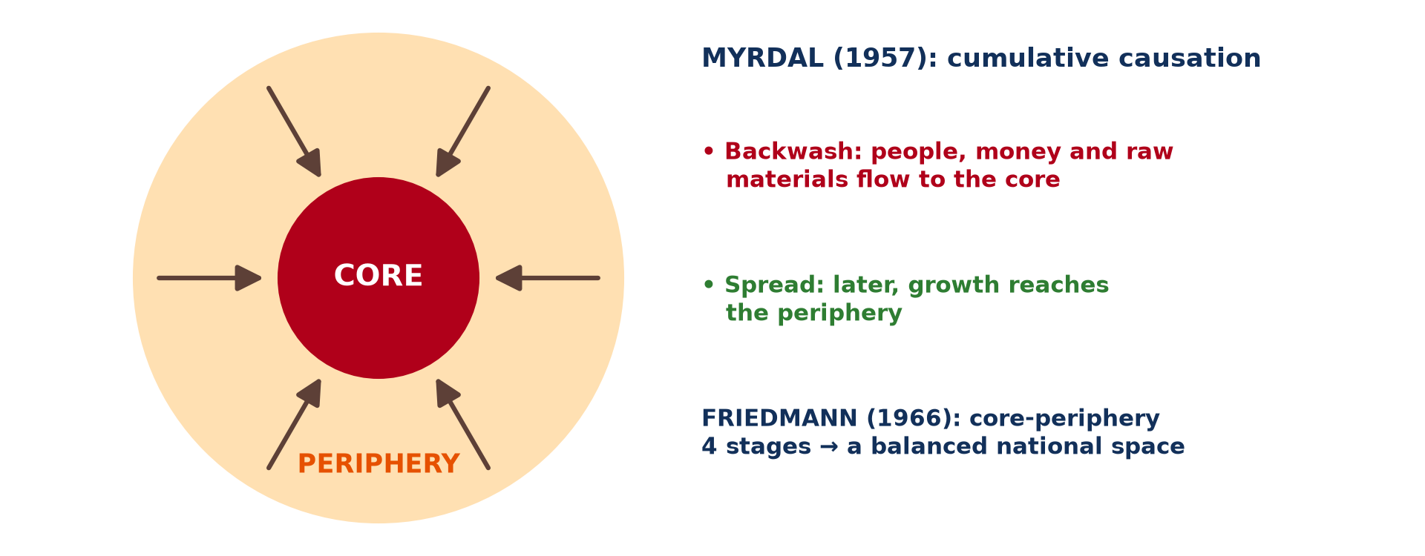
1. MODELS OF REGIONAL INEQUALITY
Activity 1
A core and its periphery.
Notes:
Activity 1. Look carefully at this diagram: a core and its periphery. Observe every detail before I ask the question.

Slide 21
1. MODELS OF REGIONAL INEQUALITY
Activity 1: Question
Where do skilled people and capital go in the core-periphery model?
Notes:
Here is the question for Activity 1: Where do skilled people and capital go in the core-periphery model? Take one minute to think and write your answer in your rough notebook.

Slide 22
1. MODELS OF REGIONAL INEQUALITY
Activity 1: Answer
Towards the core (the most developed region).
Notes:
Let us check the answer together. Towards the core (the most developed region).

Slide 23
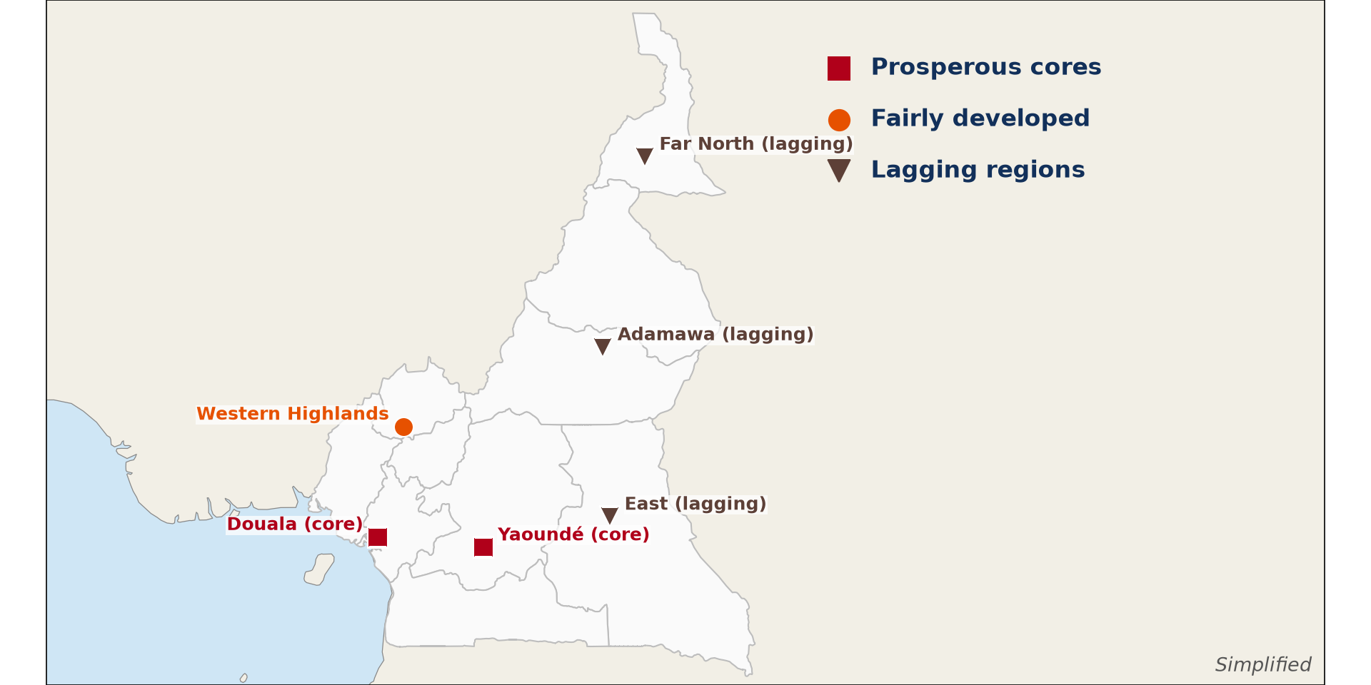
2. CONTRASTING REGIONS
Activity 2
Prosperous and lagging regions.
Notes:
Activity 2. Look carefully at this diagram: prosperous and lagging regions. Observe every detail before I ask the question.

Slide 24
2. CONTRASTING REGIONS
Activity 2: Question
Is Douala a prosperous or a lagging region?
Notes:
Here is the question for Activity 2: Is Douala a prosperous or a lagging region? Take one minute to think and write your answer in your rough notebook.

Slide 25
2. CONTRASTING REGIONS
Activity 2: Answer
A prosperous region (a core).
Notes:
Let us check the answer together. A prosperous region (a core).

Slide 26
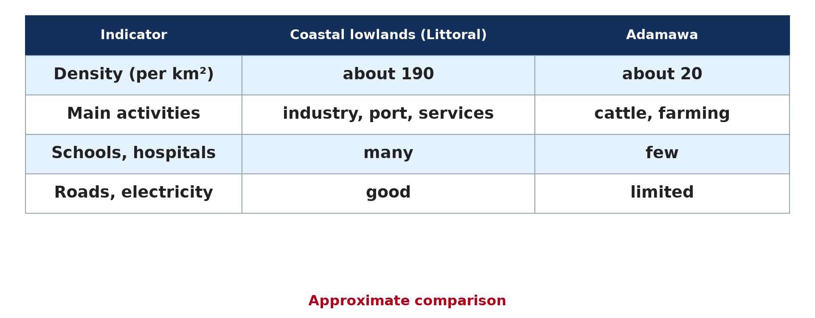
3. INDICATORS
Activity 3
Coastal lowlands and Adamawa compared.
Notes:
Activity 3. Look carefully at this diagram: coastal lowlands and Adamawa compared. Observe every detail before I ask the question.

Slide 27
3. INDICATORS
Activity 3: Question
Which region has more schools and hospitals?
Notes:
Here is the question for Activity 3: Which region has more schools and hospitals? Take one minute to think and write your answer in your rough notebook.

Slide 28
3. INDICATORS
Activity 3: Answer
The coastal lowlands (Littoral).
Notes:
Let us check the answer together. The coastal lowlands (Littoral).

Slide 29

4. FACTORS
Activity 4
Douala.
Notes:
Activity 4. Look carefully at this picture: douala. Observe every detail before I ask the question.

Slide 30
4. FACTORS
Activity 4: Question
Give one natural advantage of the coastal lowlands.
Notes:
Here is the question for Activity 4: Give one natural advantage of the coastal lowlands. Take one minute to think and write your answer in your rough notebook.

Slide 31
4. FACTORS
Activity 4: Answer
Access to the sea (port), also oil and fertile soils.
Notes:
Let us check the answer together. Access to the sea (port), also oil and fertile soils.

Slide 32

5. MEASURES
Activity 5
A school.
Notes:
Activity 5. Look carefully at this picture: a school. Observe every detail before I ask the question.

Slide 33
5. MEASURES
Activity 5: Question
How can building schools in lagging regions reduce inequality?
Notes:
Here is the question for Activity 5: How can building schools in lagging regions reduce inequality? Take one minute to think and write your answer in your rough notebook.

Slide 34
5. MEASURES
Activity 5: Answer
It trains local people, who can find better jobs and develop their region.
Notes:
Let us check the answer together. It trains local people, who can find better jobs and develop their region.

Slide 35
BOARD SUMMARY
Board Summary
Topic: Geography of Cameroon
Sub-topic: Economic Activities and Development of Cameroon
Lesson 15: Contrasts in Development within Cameroon
Notes:
Now we are going to copy the board summary. Write the title and the headings neatly in your notebooks. I will give you enough time for each slide, so do not rush.

Slide 36
BOARD SUMMARY
DEFINITIONS
The key terms of this lesson are defined as follows:
Development: It is the improvement of the living conditions of people (income, health, education, services).
Regional inequality: It is the unequal level of development between regions of a country.
Notes:
Let us copy the definitions. The key terms of this lesson are defined as follows. On this slide we have Development and Regional inequality. Write each point on a new line, with the key term first, and explain it in your own words when we revise. When you finish, we go to the next slide.

Slide 37
BOARD SUMMARY
DEFINITIONS (continued)
Core: It is a prosperous region where population, capital and activities are concentrated.
Periphery: It is a less developed region that depends on the core.
Notes:
We continue with the definitions. On this slide we have Core and Periphery. Write each point on a new line, with the key term first, and explain it in your own words when we revise.

Slide 38
BOARD SUMMARY
1. Recall of the Models of Regional Inequality
Regional inequality is explained by the following models:
Myrdal's cumulative causation (1957): A region with an initial advantage, such as a port or a capital, attracts investment and grows. Its growth then attracts even more activities, so the advantage keeps increasing by a cumulative process.
Illustration: the core and the periphery
Notes:
Let us copy Recall of the Models of Regional Inequality. Regional inequality is explained by the following models. Copy the point on Myrdal's cumulative causation (1957) on the left, then draw the diagram on the right: the core and the periphery. Give it a title and label it clearly.

Slide 39
BOARD SUMMARY
1. Recall of the Models of Regional Inequality
Backwash and spread effects: The growing region draws labour, capital and raw materials from poorer regions, which is the backwash effect. Later, some growth spreads to them through demand for their products, which is the spread effect, but backwash is often stronger.
Notes:
We continue with Recall of the Models of Regional Inequality. Copy the point on Backwash and spread effects: write the key term first, then its explanation.

Slide 40
BOARD SUMMARY
1. Recall of the Models of Regional Inequality
Friedmann's core-periphery model (1966): A dominant core concentrates wealth, while a dependent periphery supplies it with labour and raw materials. Inequality grows in the early stages of development and may fall later, when development spreads to the periphery.
Notes:
We continue with Recall of the Models of Regional Inequality. Copy the point on Friedmann's core-periphery model (1966): write the key term first, then its explanation.

Slide 41
BOARD SUMMARY
2. The Contrasting Regions: Case Study
The case study compares the following two regions:
The prosperous region, the Coastal lowlands: With Douala, Limbe and Kribi, the Coastal lowlands are the economic heart of Cameroon. They concentrate the port, industries, plantations, oil and most services.
Illustration: a prosperous and a lagging region
Notes:
Let us copy The Contrasting Regions: Case Study. The case study compares the following two regions. Copy the point on The prosperous region, the Coastal lowlands on the left, then draw the diagram on the right: a prosperous and a lagging region. Give it a title and label it clearly.

Slide 42
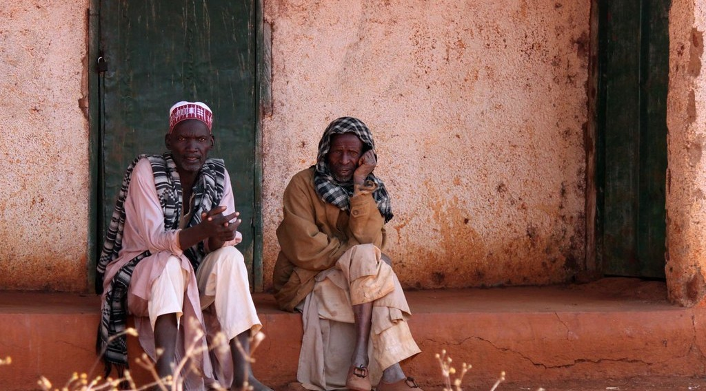
BOARD SUMMARY
2. The Contrasting Regions: Case Study
The lagging region, the Adamawa: The Adamawa is a high, landlocked plateau, sparsely populated and far from the sea. Its people live mainly from cattle rearing and farming.
Illustration: the Adamawa
Notes:
Copy the point on The lagging region, the Adamawa on the left, then draw the diagram on the right: the Adamawa. Give it a title and label it clearly.

Slide 43
BOARD SUMMARY
3. Indicators of Differences in Development
The differences between the two regions are shown by the following indicators:
Income and poverty: In 2014, only about 4 % of the people of Douala were poor, against about 47 % in the Adamawa. Incomes are therefore much higher on the coast.
Illustration: indicators of development
Notes:
Let us copy Indicators of Differences in Development. The differences between the two regions are shown by the following indicators. Copy the point on Income and poverty on the left, then draw the diagram on the right: indicators of development. Give it a title and label it clearly.

Slide 44
BOARD SUMMARY
3. Indicators of Differences in Development
Employment: The coast offers many formal jobs in industry, the port and services, with regular wages. In the Adamawa, most people work in farming and herding, with low and irregular incomes.
Notes:
We continue with Indicators of Differences in Development. Copy the point on Employment: write the key term first, then its explanation.

Slide 45
BOARD SUMMARY
3. Indicators of Differences in Development
Education and health: The coast has many schools, universities such as Douala and Buea, hospitals and doctors. The Adamawa has fewer schools and health centres, and lower school enrolment.
Notes:
We continue with Indicators of Differences in Development. Copy the point on Education and health: write the key term first, then its explanation.

Slide 46
BOARD SUMMARY
3. Indicators of Differences in Development
Other infrastructure: Paved roads, electricity, piped water and internet are much better on the coast. Many villages of the Adamawa still lack them.
Notes:
We continue with Indicators of Differences in Development. Copy the point on Other infrastructure: write the key term first, then its explanation.

Slide 47
BOARD SUMMARY
4. Factors of the Inequality
The inequality is explained by the following factors:
Natural resources and position: The coast has the sea, oil, gas and fertile volcanic soils, and it is the gateway for trade. The Adamawa is landlocked, far from the ports and has poorer soils.
Illustration: Douala
Notes:
Let us copy Factors of the Inequality. The inequality is explained by the following factors. Copy the point on Natural resources and position on the left, then draw the diagram on the right: douala. Give it a title and label it clearly.

Slide 48
BOARD SUMMARY
4. Factors of the Inequality
Human resources: The coast attracts skilled people and has more educated workers. The Adamawa loses many of its young people to the towns of the south, which is the backwash effect.
Notes:
We continue with Factors of the Inequality. Copy the point on Human resources: write the key term first, then its explanation.

Slide 49
BOARD SUMMARY
4. Factors of the Inequality
Historical factors: The colonial rulers invested first on the coast, where they built the port, the railway and the plantations. This early advantage has lasted until today.
Notes:
We continue with Factors of the Inequality. Copy the point on Historical factors: write the key term first, then its explanation.

Slide 50
BOARD SUMMARY
4. Factors of the Inequality
Government policy and investment: For a long time, public investment was concentrated in Douala and Yaoundé. This attracted private investment there and left other regions behind.
Notes:
We continue with Factors of the Inequality. Copy the point on Government policy and investment: write the key term first, then its explanation.

Slide 51
BOARD SUMMARY
5. Measures Attempted to Reduce Inequality
A) Political and Administrative Measures
Each measure reduces the gap between the rich coast and lagging regions such as the Adamawa and the North in the following way:
Decentralisation: The State transfers powers and money to elected Regional Councils (since 2020) and to councils. It reduces inequality because decisions and money are no longer concentrated in Yaoundé; each region can spend its own budget on its own roads, schools and water points.
Notes:
Let us copy Political and Administrative Measures. Each measure reduces the gap between the rich coast and lagging regions such as the Adamawa and the North in the following way. Copy the point on Decentralisation: write the key term first, then its explanation.

Slide 52
BOARD SUMMARY
5. Measures Attempted to Reduce Inequality
A) Political and Administrative Measures
Regional development agencies (MEADEN in the North, MIDENO and UNVDA in the North-West): These bodies bring projects, technicians and money to regions that private investors neglect. They reduce inequality because they replace the missing private investment and create jobs and income where there were few.
Notes:
We continue with Political and Administrative Measures. Copy the point on Regional development agencies (MEADEN in the North, MIDENO and UNVDA in the North-West): write the key term first, then its explanation.

Slide 53
BOARD SUMMARY
5. Measures Attempted to Reduce Inequality
A) Political and Administrative Measures
Special reconstruction plans (Far North, North-West, South-West): The State rebuilds schools, health centres and roads destroyed by insecurity. They reduce inequality because they stop these regions from falling further behind and allow people to return and work.
Notes:
We continue with Political and Administrative Measures. Copy the point on Special reconstruction plans (Far North, North-West, South-West): write the key term first, then its explanation.

Slide 54
BOARD SUMMARY
5. Measures Attempted to Reduce Inequality
B) Socio-Economic Measures
Each measure reduces the gap between the rich coast and lagging regions such as the Adamawa and the North in the following way:
Roads and railway (National Road No. 1, Ngaoundéré–Garoua road, railway to Ngaoundéré): Remote regions are connected to markets and to the port of Douala. This reduces inequality because transport becomes cheaper and faster, so farmers and herders sell more at better prices, and firms can settle outside the coast.
Notes:
Let us copy Socio-Economic Measures. Each measure reduces the gap between the rich coast and lagging regions such as the Adamawa and the North in the following way. Copy the point on Roads and railway (National Road No. 1, Ngaoundéré–Garoua road, railway to Ngaoundéré): write the key term first, then its explanation.

Slide 55
BOARD SUMMARY
5. Measures Attempted to Reduce Inequality
B) Socio-Economic Measures
Electricity and water (Lagdo dam, rural electrification): The North receives electricity and water for irrigation. This reduces inequality because factories, mills and shops can work, and irrigated rice gives farmers a second harvest and more income.
Notes:
We continue with Socio-Economic Measures. Copy the point on Electricity and water (Lagdo dam, rural electrification): write the key term first, then its explanation.

Slide 56
BOARD SUMMARY
5. Measures Attempted to Reduce Inequality
B) Socio-Economic Measures
Support to agriculture and livestock (SODECOTON, Adamawa livestock projects): Farmers receive seeds, fertiliser and a guaranteed market. This reduces inequality because it raises incomes in rural regions whose economy depends almost only on farming and herding.
Notes:
We continue with Socio-Economic Measures. Copy the point on Support to agriculture and livestock (SODECOTON, Adamawa livestock projects): write the key term first, then its explanation.

Slide 57
BOARD SUMMARY
5. Measures Attempted to Reduce Inequality
B) Socio-Economic Measures
Universities and hospitals (Ngaoundéré 1993, Maroua 2008, Garoua 2022; regional hospitals): Higher education and health care come closer to the people. This reduces inequality because young people study near home instead of leaving for Douala or Yaoundé, skilled workers stay in their region, and people live healthier and work more.
Notes:
We continue with Socio-Economic Measures. Copy the point on Universities and hospitals (Ngaoundéré 1993, Maroua 2008, Garoua 2022; regional hospitals): write the key term first, then its explanation.

Slide 58
BOARD SUMMARY
5. Measures Attempted to Reduce Inequality
C) Difficulties and Challenges
These measures have only partly reduced inequality for the following reasons:
Limited funding and poor management: The national budget is small, large projects such as roads and dams often depend on foreign loans, and part of the money is misused. As a result, many projects in lagging regions are delayed, badly built or left unfinished.
Notes:
Let us copy Difficulties and Challenges. These measures have only partly reduced inequality for the following reasons. Copy the point on Limited funding and poor management: write the key term first, then its explanation.

Slide 59
BOARD SUMMARY
5. Measures Attempted to Reduce Inequality
C) Difficulties and Challenges
Incomplete decentralisation: Regional and local councils still receive only a small share of the State budget and lack qualified staff. They therefore cannot really plan and finance their own development, and many decisions are still taken in Yaoundé.
Notes:
We continue with Difficulties and Challenges. Copy the point on Incomplete decentralisation: write the key term first, then its explanation.

Slide 60
BOARD SUMMARY
5. Measures Attempted to Reduce Inequality
C) Difficulties and Challenges
Insecurity: Boko Haram attacks in the Far North and the crisis in the North-West and South-West have destroyed schools, health centres, markets and roads. Investors and civil servants avoid these regions, and many people have fled, so the gap with the coast has widened.
Notes:
We continue with Difficulties and Challenges. Copy the point on Insecurity: write the key term first, then its explanation.

Slide 61
BOARD SUMMARY
5. Measures Attempted to Reduce Inequality
C) Difficulties and Challenges
Strong backwash effects: Douala and Yaoundé keep attracting capital, industries and educated young people from the whole country. Growth spreads to the periphery much more slowly than resources leave it, as Myrdal's model predicts.
Notes:
We continue with Difficulties and Challenges. Copy the point on Strong backwash effects: write the key term first, then its explanation.

Slide 62
FORMATIVE EVALUATION
Evaluation 1
Distinguish between backwash and spread effects.
Notes:
Now let us check what you have understood. Question 1: Distinguish between backwash and spread effects. Answer in your exercise book.

Slide 63
FORMATIVE EVALUATION
Expected Answer
Backwash effects draw labour and capital from poor regions to the core; spread effects are the growth that spreads from the core to poorer regions.
Notes:
The expected answer is: backwash effects draw labour and capital from poor regions to the core; spread effects are the growth that spreads from the core to poorer regions. If you got it right, well done.

Slide 64
FORMATIVE EVALUATION
Evaluation 2
Give two indicators that show that the coast is more developed than the Adamawa.
Notes:
Now let us check what you have understood. Question 2: Give two indicators that show that the coast is more developed than the Adamawa. Answer in your exercise book.

Slide 65
FORMATIVE EVALUATION
Expected Answer
Lower poverty and more schools and hospitals (also more formal jobs and better roads).
Notes:
The expected answer is: lower poverty and more schools and hospitals (also more formal jobs and better roads). If you got it right, well done.

Slide 66
REMEDIATION
Remediation
Fill in the blanks:
The prosperous region in the core-periphery model is the ______.
The model of cumulative causation was proposed by ______.
Notes:
Take your time to copy this part; we will continue together.

Slide 67
REMEDIATION
Remediation (continued)
Giving powers to regional and local councils is ______.
Notes:
For those who need more practice, fill in the blanks in your exercise book. The answers are: number 1, core; number 2, Myrdal; number 3, decentralisation.

Slide 68
HOMEWORK
Homework
List three indicators of development.
Notes:
For your homework: List three indicators of development. We shall correct it at the beginning of our next lesson.

Slide 69
BILINGUAL GAME
Bilingual Game (Jeu Bilingue)
English | Français
Development | Le développement
Regional inequality | L'inégalité régionale
Core | Le centre
Periphery | La périphérie
Poverty | La pauvreté
Indicator | L'indicateur
Decentralisation | La décentralisation
Infrastructure | L'infrastructure
Notes:
Let us play the bilingual game. I say a word in English, and you give me the French word. Then we do the reverse.

Slide 70
LOGBOOK
Official Logbook (1/2)
Module / Topic | Geography of Cameroon
Lesson Title | Lesson 15: Contrasts in Development within Cameroon
Expected Learning Outcomes | Recall the models of Friedmann and Myrdal. Compare a prosperous region and a lagging region with indicators of development. Explain the factors of the inequality. Assess the measures attempted to reduce regional inequality.
Competence | Learners are able to explain the contrasts in development between regions of Cameroon and assess the measures taken to reduce them.
Notes:
I record this information in the official logbook of the class after the lesson.

Slide 71
LOGBOOK
Official Logbook (2/2)
Matter Taught | DEFINITIONS; Recall of the Models of Regional Inequality; The Contrasting Regions: Case Study; Indicators of Differences in Development; Factors of the Inequality; Political and Administrative Measures; Socio-Economic Measures; Difficulties and Challenges.
Evaluation | Formative evaluation and remediation exercise.
Homework | List three indicators of development.
Enrolment / Present / Absent | ____ / ____ / ____
Achievement | To be completed after the lesson.
Notes:
I complete the second page of the logbook: the matter taught, the evaluation, the homework and the attendance.

Slide 72
TEACHER'S NOTE
Teacher's Note
Timing: Homework correction, plan, objectives 8 min | Recall, situation, action 10 min | 5 activities 30 min | Board summary (copying) 30 min | Evaluation, remediation 10 min | Homework, next lesson 5 min | Logbook 7 min
Without the projector (Activity 1): draw a core and its periphery.
Without the projector (Activity 2): mark cores and lagging regions.
Without the projector (Activity 3): copy the table.
Without the projector (Activity 4): compare Douala and Ngaoundéré.
Without the projector (Activity 5): name new universities of the north.
Notes:
This slide is for me, the teacher: it gives the timing of the lesson and what to do if the projector is not available.

Slide 73
REFERENCES
References
Geography Syllabus for Sixth Forms (Lower and Upper Sixth), MINESEC, 2019 — Geography of Cameroon.
Teacher's course notes: Mr KAMDEM E., Cameroon Geography (LSA and USA), GBHS Garoua, 2026.
INS, Fourth Cameroon Household Survey (ECAM 4), 2014.
Photo, Activity 4: “Douala” by christing-O-, CC BY 2.0, via Flickr (https://www.flickr.com/photos/76187282@N00/7227535754)
Photo, Activity 5: “Students in Primary Seven at Zanaki Primary School” by World Bank Photo Collection, CC BY-NC-ND 2.0, via Flickr (https://www.flickr.com/photos/10816734@N03/33423887921)
Photo, board summary (The lagging region, the Adamawa): “At Dang and its livestock market” by 10b travelling / Carsten ten Brink, CC BY-NC-ND 2.0, via Flickr (https://www.flickr.com/photos/77334245@N00/7311224966)
Diagrams and animations: drawn for this lesson (Geography Department).
Notes:
These are the references and picture credits used to prepare this lesson.

